Slide 1

LY TU TRONG COLLEGE
ENGLISH DEPARTMENT
Teacher’s name:
VƯƠNG THANH THUỶ

Slide 2
UNIT 5B
AMERICAN ENGLISH FILES 2
SUPERLATIVE CITIES
1. GRAMMAR
Page 38

Slide 3
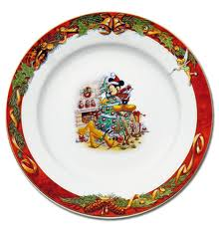
1. As + adjective + as
The things are the same
This plate is as big as that one.

Slide 4
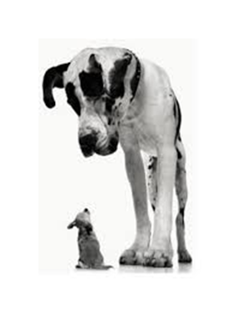
Not as + adjective + as
This dog is not as big as that one.

Slide 5

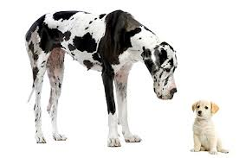
Comparison of Adjectives

Slide 6
2. Comparative Adjectives (to compare 2 people or things)
Short adjectives Long adjectives
adjective + er + than more + adjective
+ than
hot hotter than beautiful more
beautiful than

Slide 7
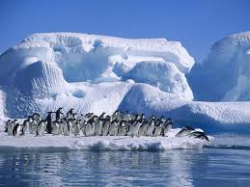
Short adjective + er + than
This place is colder than
your freezer.

Slide 8
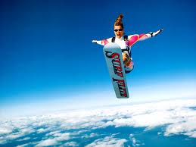
More + long adjective + than
Extreme sports are more exciting than
regular sports.

Slide 9
3. Superlative Adjectives
(to compare at least 3 people or things)
Short adjectives Long adjectives
the + short adjective + est the most + long adjective
It is the hottest place She is the most beautiful
in the world. girl in our school.

Slide 10

Spelling Rules
1. One syllable (CVC) double the last consonant when adding er or est
big – bigger than – the biggest.
2. A final y after a consonant i
scary – scarier than – the scariest.
3.cute – cuter than – the cutest

Slide 11







Irregular Forms
good better than… the best
bad worse than… the worst
little less then the least

Slide 12


